Slide 1
Society of Saint Vincent de Paul Ontario Regional Council Treasurer’s Workshop
Brantford – September 21, 2019

Slide 2
Workshop overview
Focus will be on preparation of annual reports for Conferences with revenues less than $100,000.
Planning how to keep you records to simplify annual reporting
Examples of how to record various revenues and expenses
Completing the SSVP 9.3E1
Completing the Revenue Canada T3010
Considerations for Particular Councils and additional requirements for annual 9.3E1 and T3010.

Slide 3
Rule 2.2.7.3
The treasurer is responsible for:
Keeping records of all receipts and expenditures
Deposits are made regularly and promptly
A financial report is presented at each meeting and included in minutes
A record is kept for all paid invoices before payment is made
Cheques should be signed by two persons authorized by the conference

Slide 4
CHART OF ACCOUNTS
Books and records should be laid out to make the annual reporting as easy as possible
Set a simple chart of accounts using the account numbers on annual report form
Use the T3010 numbers as they are also used on 9.3E1

Slide 5
WHAT TO RECORD
Remember that you are only recording cash transactions – both coming in and going out
Normally you should not be concerned with accounts receivable, accounts payable or inventory at the conference level. Keep it simple and use cash basis accounting.

Slide 6
Donated goods
Value of non-cash donations, coming in and going out should be estimated and kept on separate records.
Examples include food (organized into hampers), clothing, furniture etc. received as donations and then distributed.
Keep a simple, consistent method of determining a value of these for the year.
These are to be reported annually in the 9.3 A-B Statistics – line 204, 205, 206 etc.

Slide 7
System used to keep records
Use a method/form of bookkeeping you are comfortable with, experienced with or available to you;
Simply accounting, Quick books, Excel spreadsheet, manual spreadsheet etc.
Most conferences would only have 3 or 4 revenue lines
Most conferences would only have 5 or 6 expense lines

Slide 8
Sample Spreadsheet for Conference Record Keeping

Slide 9
9.3E1 page 1
Insert revenue from records and total automatically calculates
Insert expenses from records and total expenses and net income(loss) automatically calculates

Slide 10
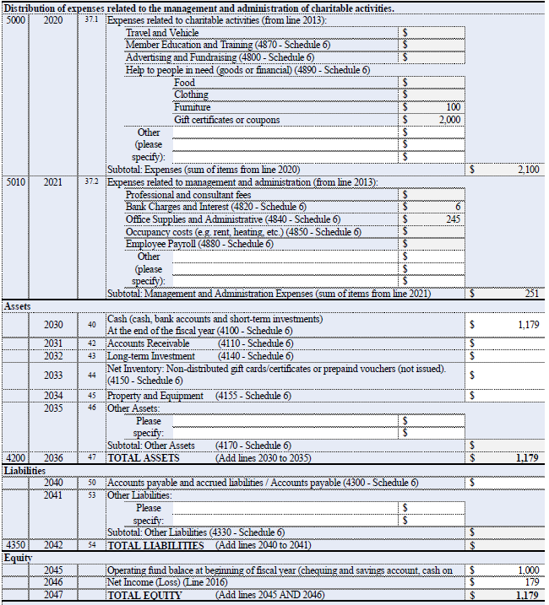
9.3E1 page 2
Distribution of expenses all automatically calculate and provides the numbers you need for breakdown at bottom of page 3 on T3010
Assets- insert your closing cash balance
Equity- insert your opening cash balance and your net income(loss) from page 1

Slide 11
9.3E1 page 3
Reasonable reserve report – all automatically calculated, unless you need to adjust for extra expenses in upcoming year. This will adjust pass-up requirement of surplus if applicable

Slide 12
Reporting deadlines
9.3E1 Conference annual reports to councils or next higher councils are due first – by January 30th
Particular Councils must report to Provincial Councils by February 20th

Slide 13
Reporting Guide
A copy of 9.4 E Annual Financial Report guide for 2019 is included with all forms that can be downloaded from the National website
The guide explains in more detail a description of items to record on appropriate lines

Slide 14
T3010 page 1

Slide 15
T3010 page 2

Slide 16
T3010 page 3
All the figures come directly from the 9.3E1
Only need to report the ending cash balance from the Balance sheet
Only need to insert revenue and expenses. No need to calculate net income

Slide 17
T3010 page 4

Slide 18
T3010 inclusions
Must include:
TF725, basic information sheet (sent to you annually)
Copy of financial statements – an absolute must – so conferences should use the 9.3E1unless you prepare your own financial statements.
T1235 – directors worksheet
T1236 – Donations made to other charities (if applicable) – includes pass ups to higher councils

Slide 19
Additional considerations for Particular Councils
Consolidated filings of all conferences for 9.3E1
T3010 must include Schedule 6 detailed financial information if revenues exceed $100,000 and schedule 3 if any compensation is paid to staff.
T3010 must also include RC232 if incorporated.
In Ontario, a registered charities can apply for a rebate of approximately 80% of all HST paid during the year. You do not register for HST purposes to apply for this rebate.

Slide 20
Resources
Financial Handbook for Conference Treasurers on National website https://www.ssvp.ca/sites/default/files/eng-financial_handbook_for_conference_treasurers-v2.1.pdf
The Rule and Statutes of SSVP Canada – specifically 2.2.7.3, 2.2.10, 2.2.11, 3.13
SSVP National website https://www.ssvp.ca/annual-reports
CRA https://www.canada.ca/en/revenue-agency/services/forms-publications/forms/t3010.html

